Slide 1
Northwind Seminary
Tutorial on How to Sign in to become a Member
Enter, and Sign-in, please…

Slide 2
Go to the Northwind website:
https://www.northwindseminary.org/

Slide 3
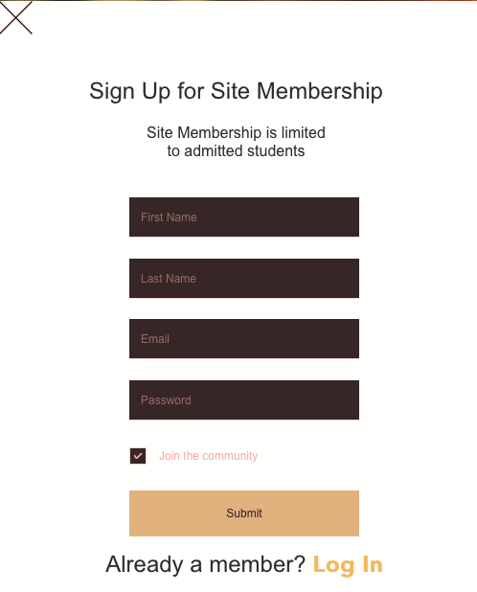
Go to the Sign Up Page:

Slide 4
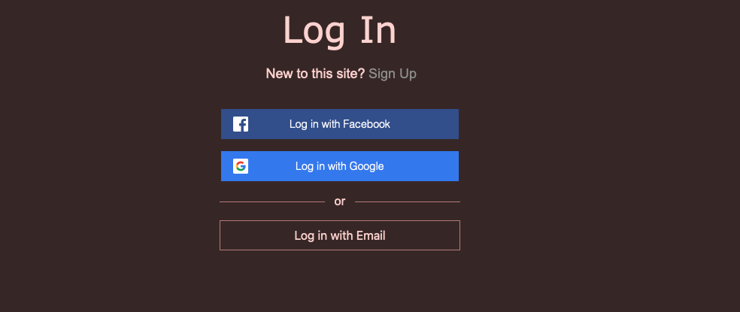
In the future, you will go to the LOG IN page:

Slide 5
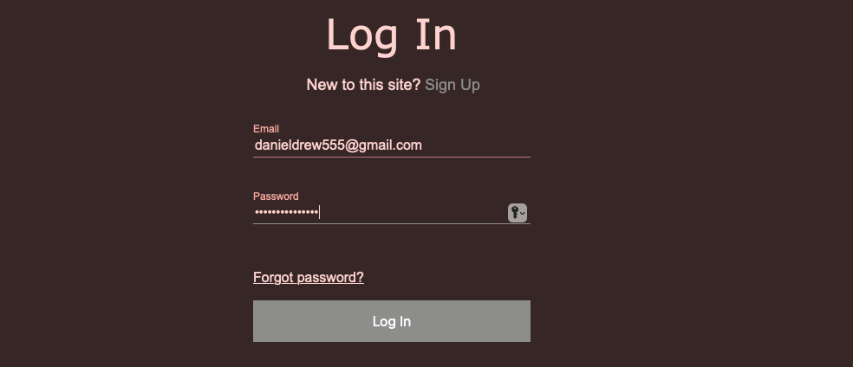
Fill in your email and choose a password:

Slide 6
You will receive an email in order to proceed:

Slide 7
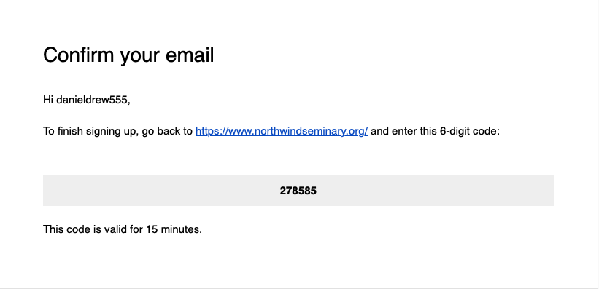
Your email will contain the following:

Slide 8
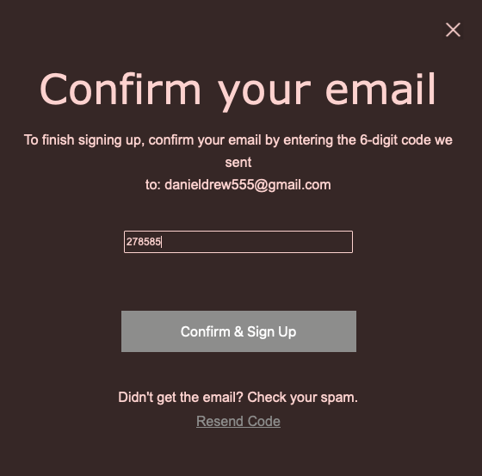
Click on the link and enter the 6-digit code:

Slide 9
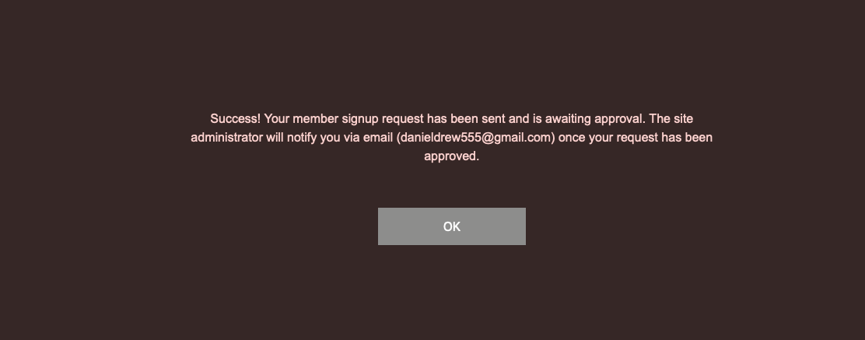
Once you do, this screen will appear:

Slide 10
Click OK and you will receive an email approval:

Slide 11
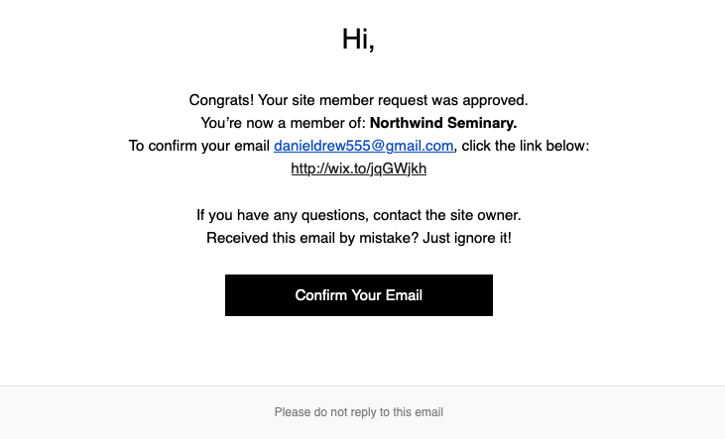
When you open that email this will appear:

Slide 12
You now have a Faculty Badge:
Think of the BADGE as a virtual ID Badge you might have used to enter restricted areas in the past.
The virtual badge that you now have precludes the need to reenter passcodes.

Slide 13
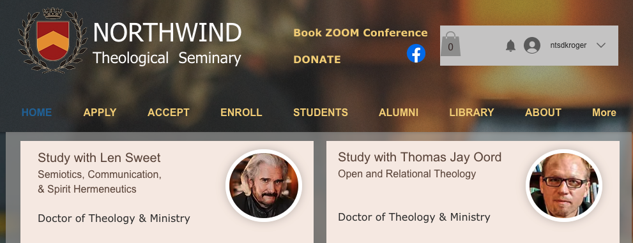
Later, when you return to the website, click on MORE from the menu bar:

Slide 14
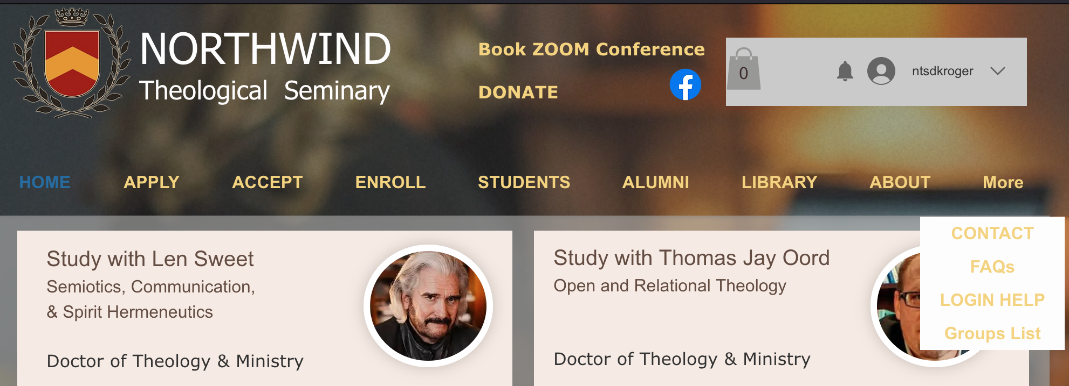
Select: Groups List

Slide 15
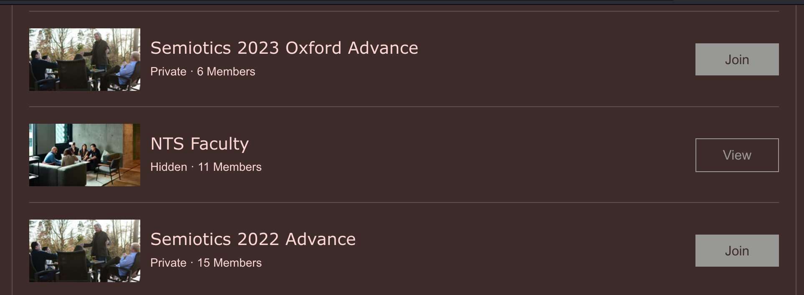
Select: NTS Faculty

Slide 16
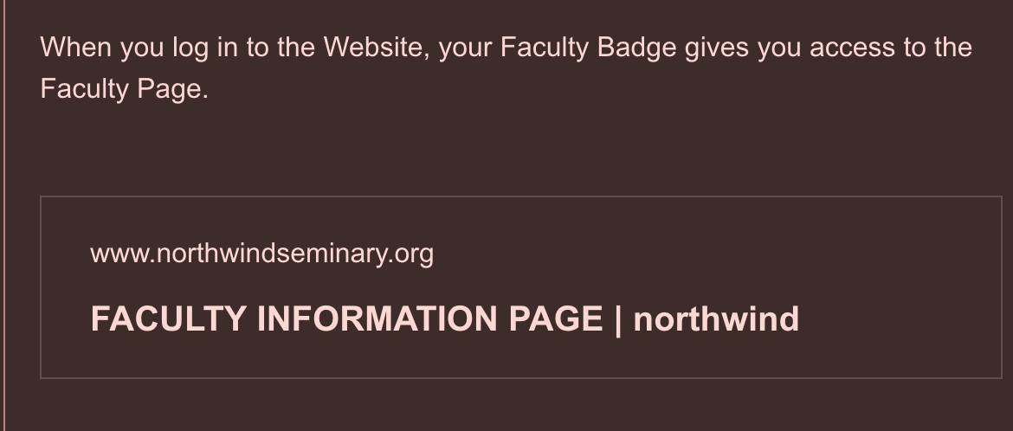
Click on the box containing: FACULTY INFORMATION PAGE Northwind (you may need to scroll to find it).

Slide 17
Click on the box containing: FACULTY INFORMATION PAGE Northwind (you may need to scroll to find it).

Slide 18
Click on the box containing: FACULTY INFORMATION PAGE Northwind (you may need to scroll to find it).

Slide 19
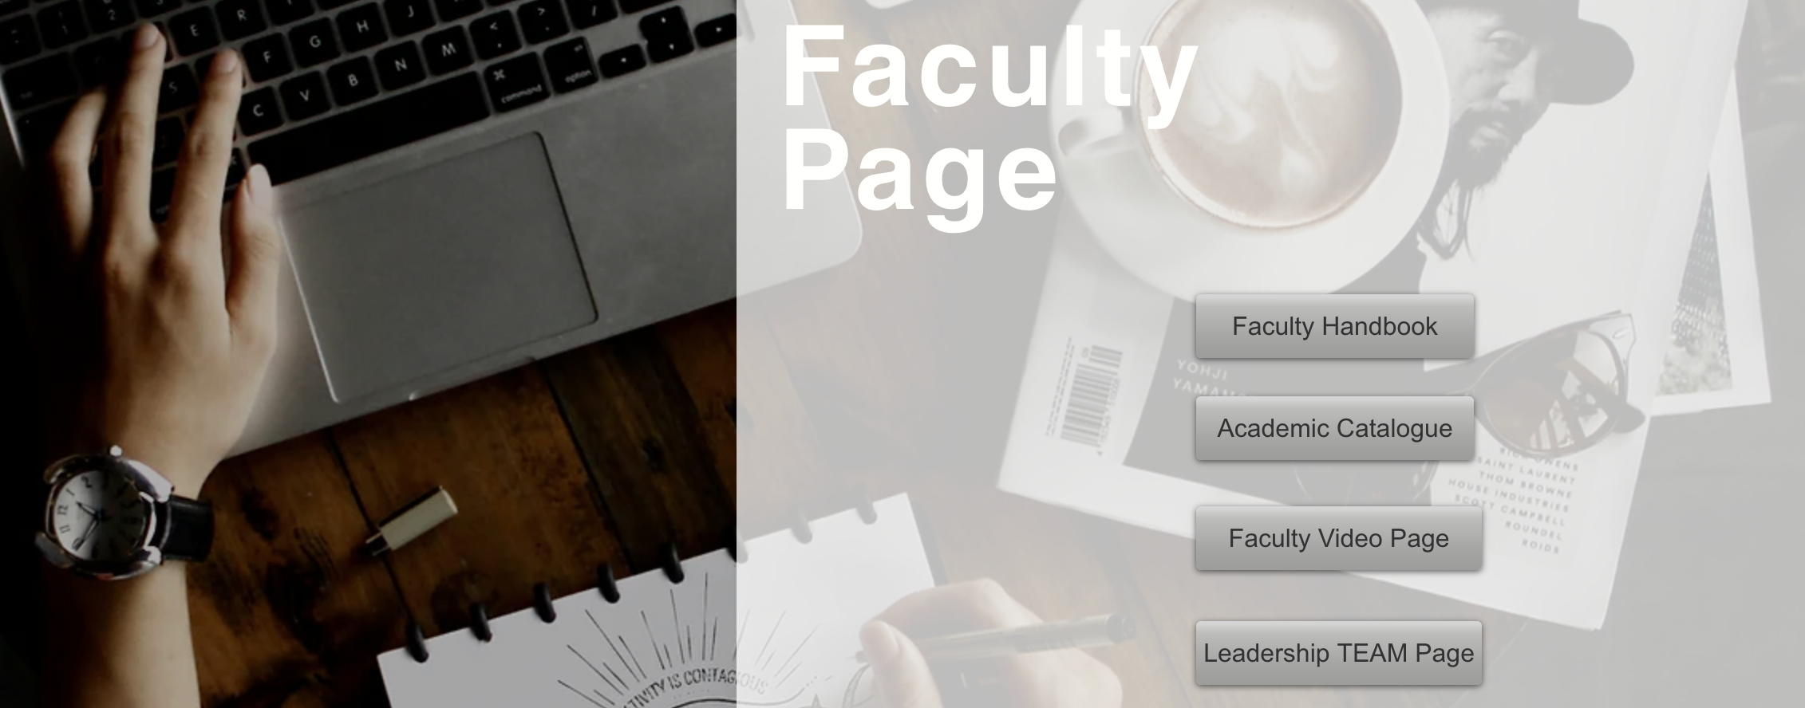
Here is the Faculty Page: Scroll down to access various forms including Classroom Design/Redesign

Slide 20
For more direct access, we encourage you to set-up a Gmail account using the following template:
NTS(your preferred name)@gmail.com
WELCOME TO NORTHWIND

