Slide 1
Northwind Seminary
Tutorial on How to Sign in to become a Member
Enter, and Sign-in, please…

Slide 2
Go to the Northwind website:
https://www.northwindseminary.org/

Slide 3
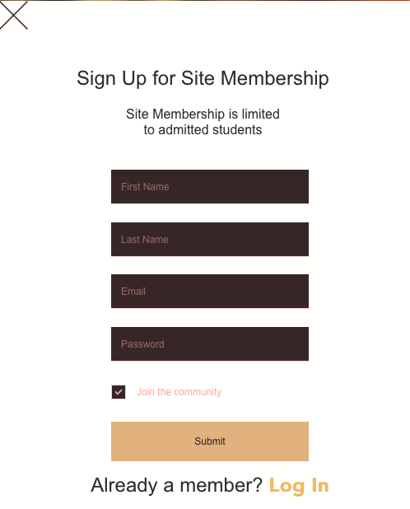
Go to the Sign Up Page:

Slide 4
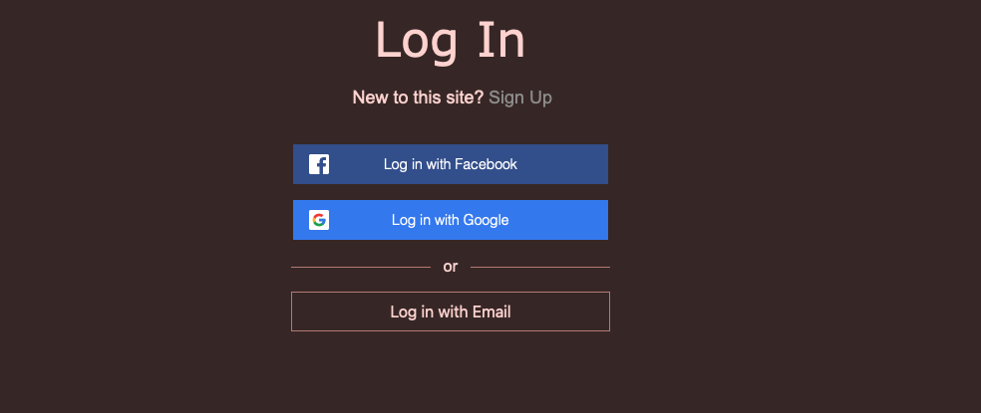
In the future, you will go to the LOG IN page:

Slide 5
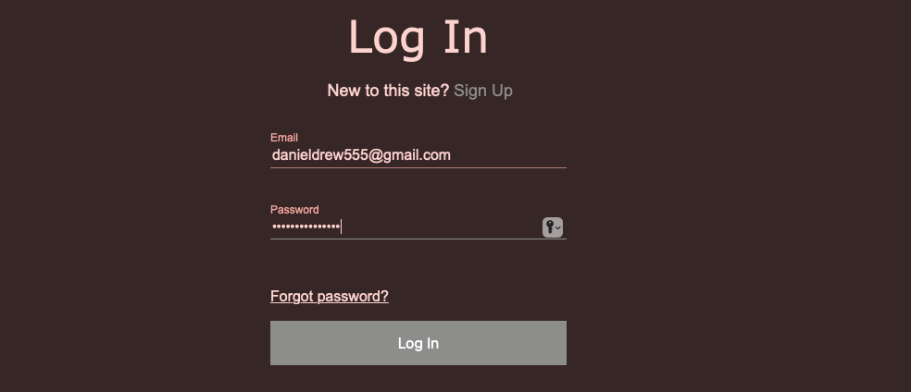
Fill in your email and choose a password:

Slide 6
You will receive an email in order to proceed:

Slide 7
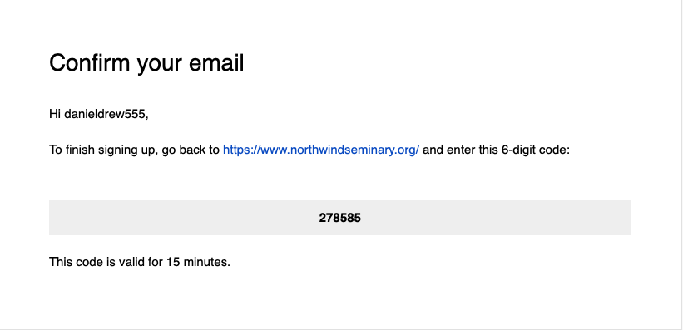
Your email will contain the following:

Slide 8
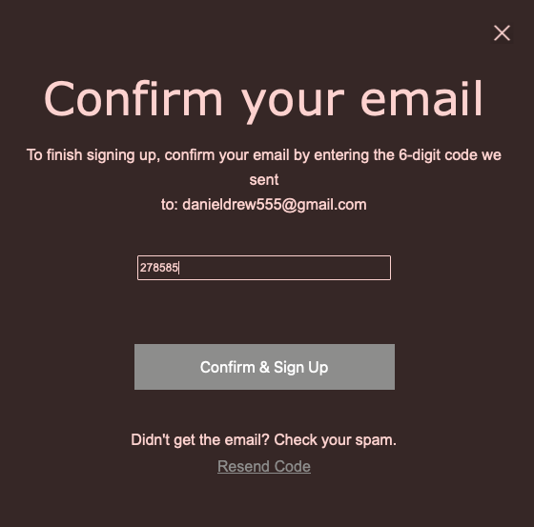
Click on the link and enter the 6-digit code:

Slide 9
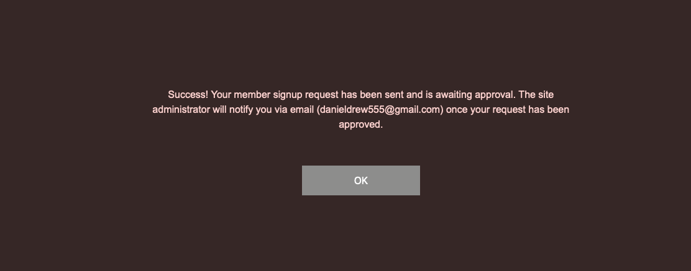
Once you do, this screen will appear:

Slide 10
Click OK and you will receive an email approval:

Slide 11
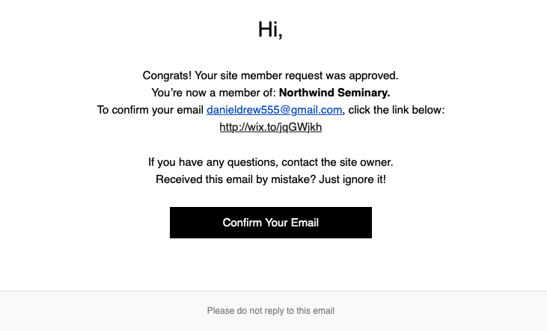
When you open that email this will appear:

Slide 12
For more direct access, we encourage you to set-up a Gmail account using the following template:
NTS(your preferred name)@gmail.com
WELCOME TO NORTHWIND

